Slide 1


Slide 2
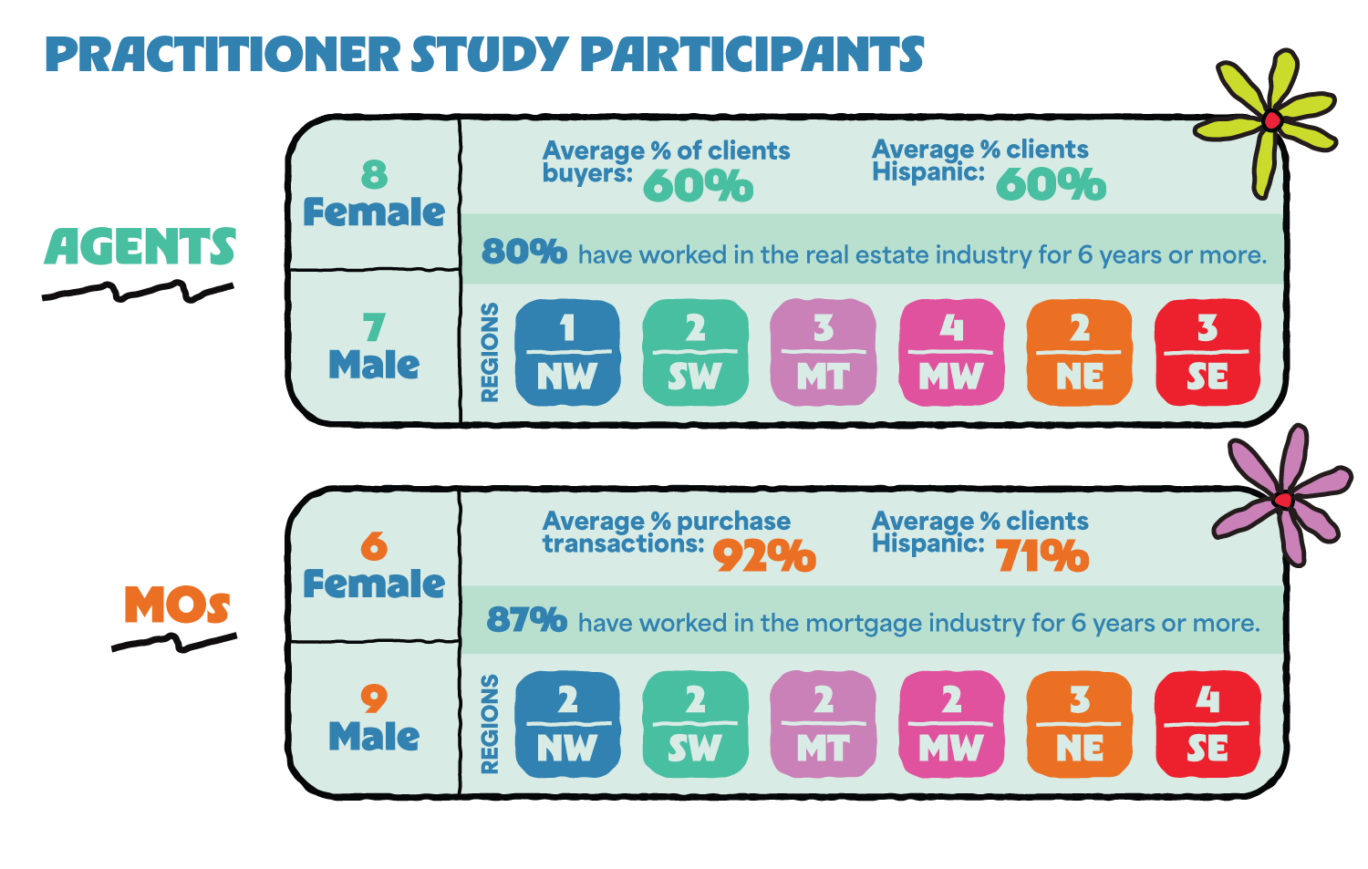

Slide 3
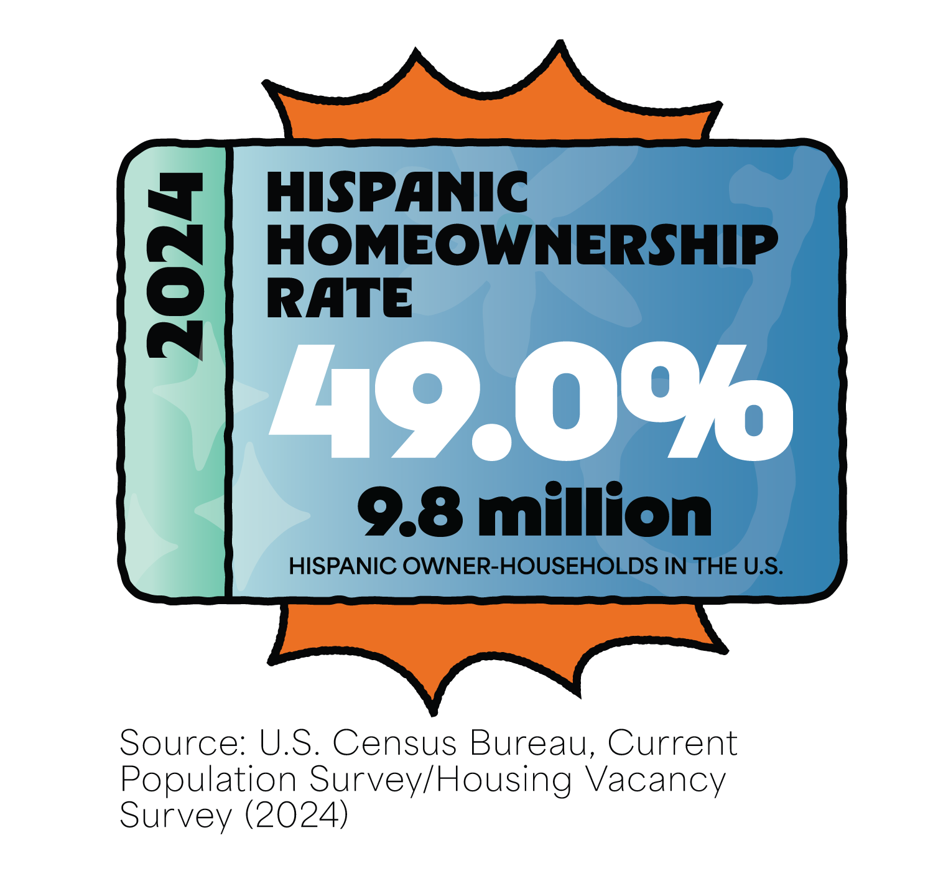
Hispanic Homeownership in 2024
In 2024, the Hispanic homeownership rate declined to 49.0%
Hispanic-owner households reach a record high of 9.8 million, a net gain of 238,000 owner-households.
In 2024, Hispanics households grew by 676,000, accounting for 43.3% of the overall household formation growth nationwide.

Slide 4
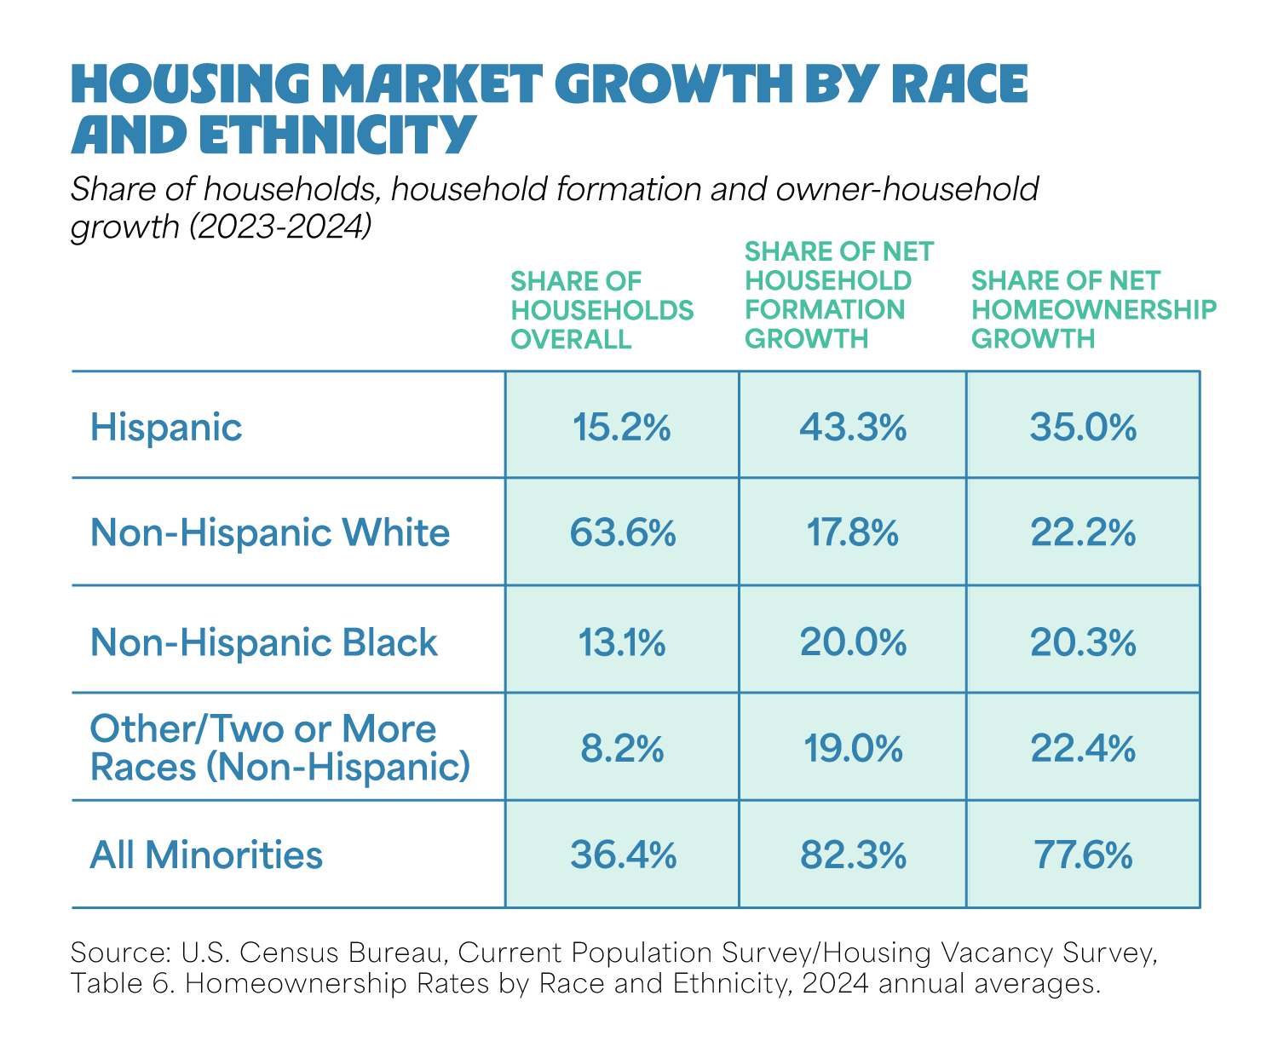
Hispanics Are Driving Market Growth
Non-White households made up 82.3 percent of household formation and 77.6 percent of owner-household gains last year.
Among them, the Hispanic community contributed the largest share of net growth.

Slide 5
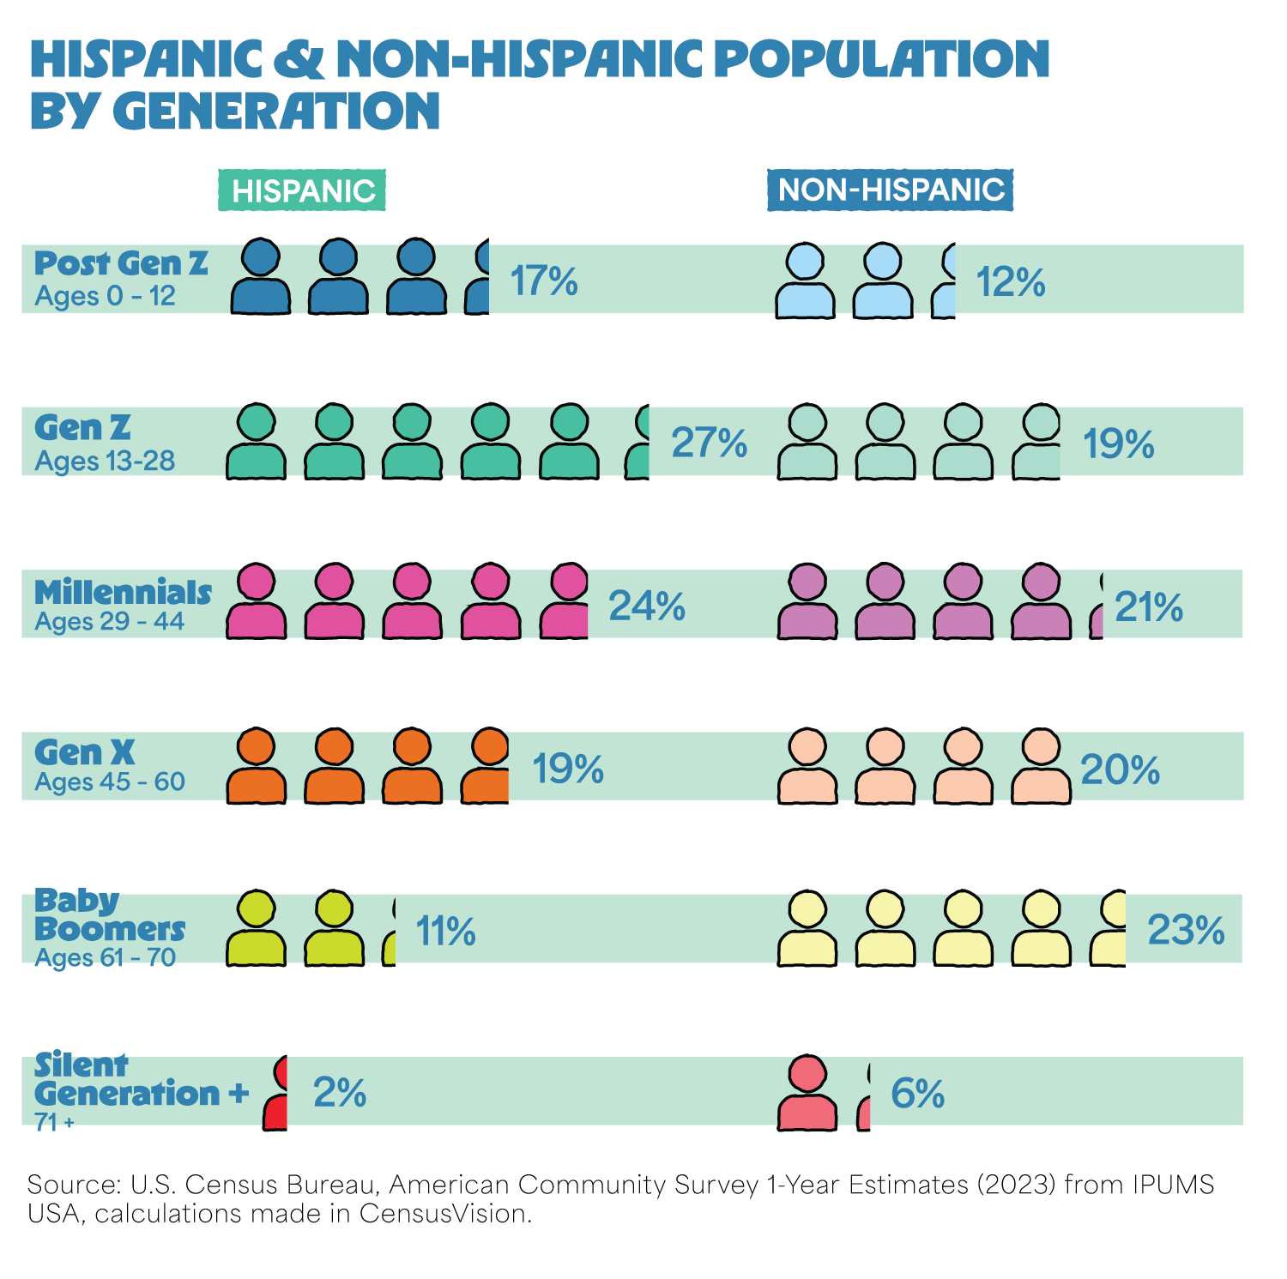
Demographic & Economic Factors
Age
Population Growth
Labor Force & Income
Education
Self-Employment
Multigenerational Living
Migration Patterns

Slide 6

Barriers to Homeownership Growth
Limited Inventory
Rising Home Prices
High Interest Rate
Broker Compensation Regulations
Political Uncertainty

Slide 7
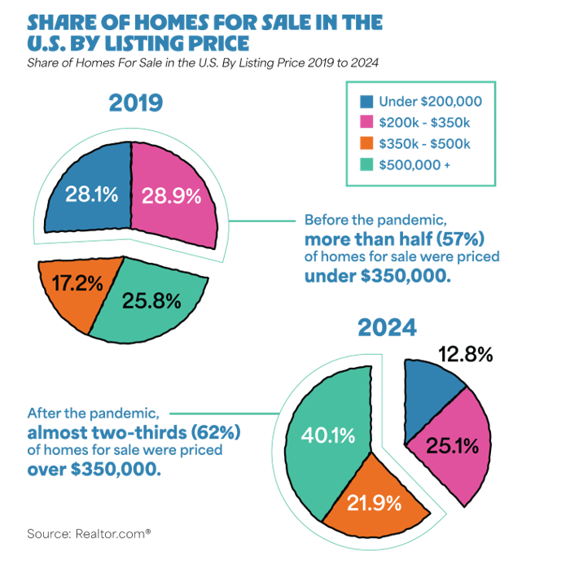
Since early 2020, home prices have increased by 47%.
Listing prices before and after the pandemic:
Before the pandemic, more than half (57%) of homes for sale were priced under $350,000.
After the pandemic, almost two-thirds (62%) were priced above $350,000

Slide 8
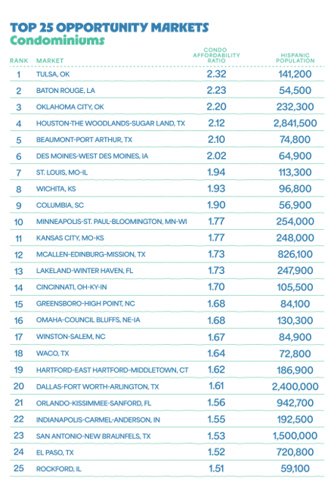
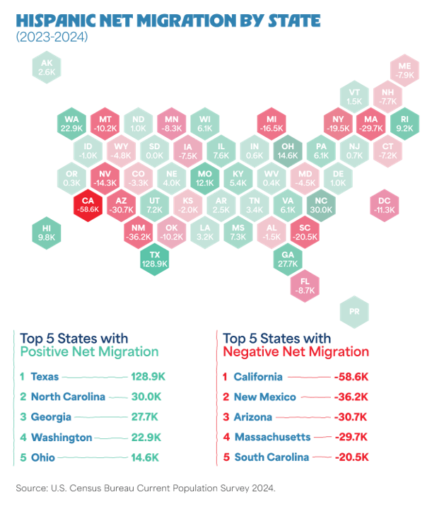
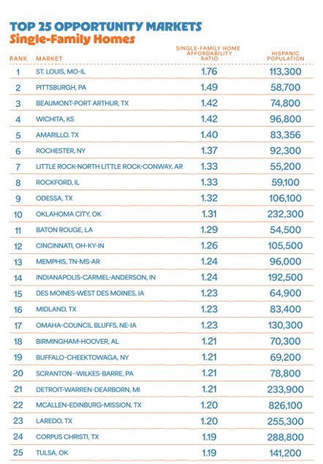
Top Opportunity Markets

Slide 9
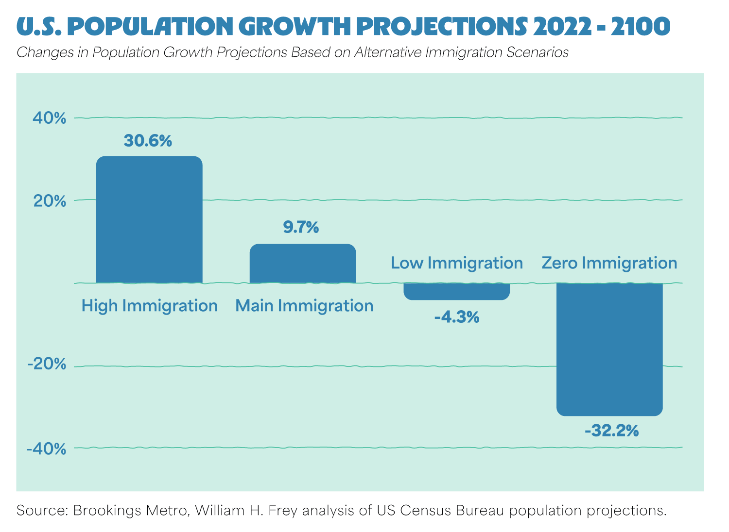
Role of Immigrants in the Housing Market
Immigrants play a key role:
Sustaining the U.S. population
Maintaining the construction labor force

Slide 10

NAHREP Policy Priorities
NAHREP focuses its advocacy efforts on four main policy areas:
Housing Affordability
Access to Credit
Industry Best Practices
Macroeconomic Issues

