Slide 1


2026 Forecast

Slide 2


2025 Forecast Recap
10-year Treasury
Forecast 3.80%
Actual 3.89%
30-year Fixed Rate Low Target
Forecast 5.75% - 6.0%
Actual 6.1%
Mortgage Spread
Forecast 2.25% (started year at 2.80%)
Actual 2.20%
Home Price Appreciation
Forecast 3.5%
Actual 2.6% (Redfin)
Unemployment Rate
Forecast 4.5%
Actual 4.56%

Slide 3

2026 Forecast
Inflation

Slide 4
Inflation
PCE
Headline 2.8%
Core 2.8%
Shelter (3.7%)
16%
18%
CPI
Headline 2.7%
Core 2.6%
Shelter
35%
44%

Slide 5
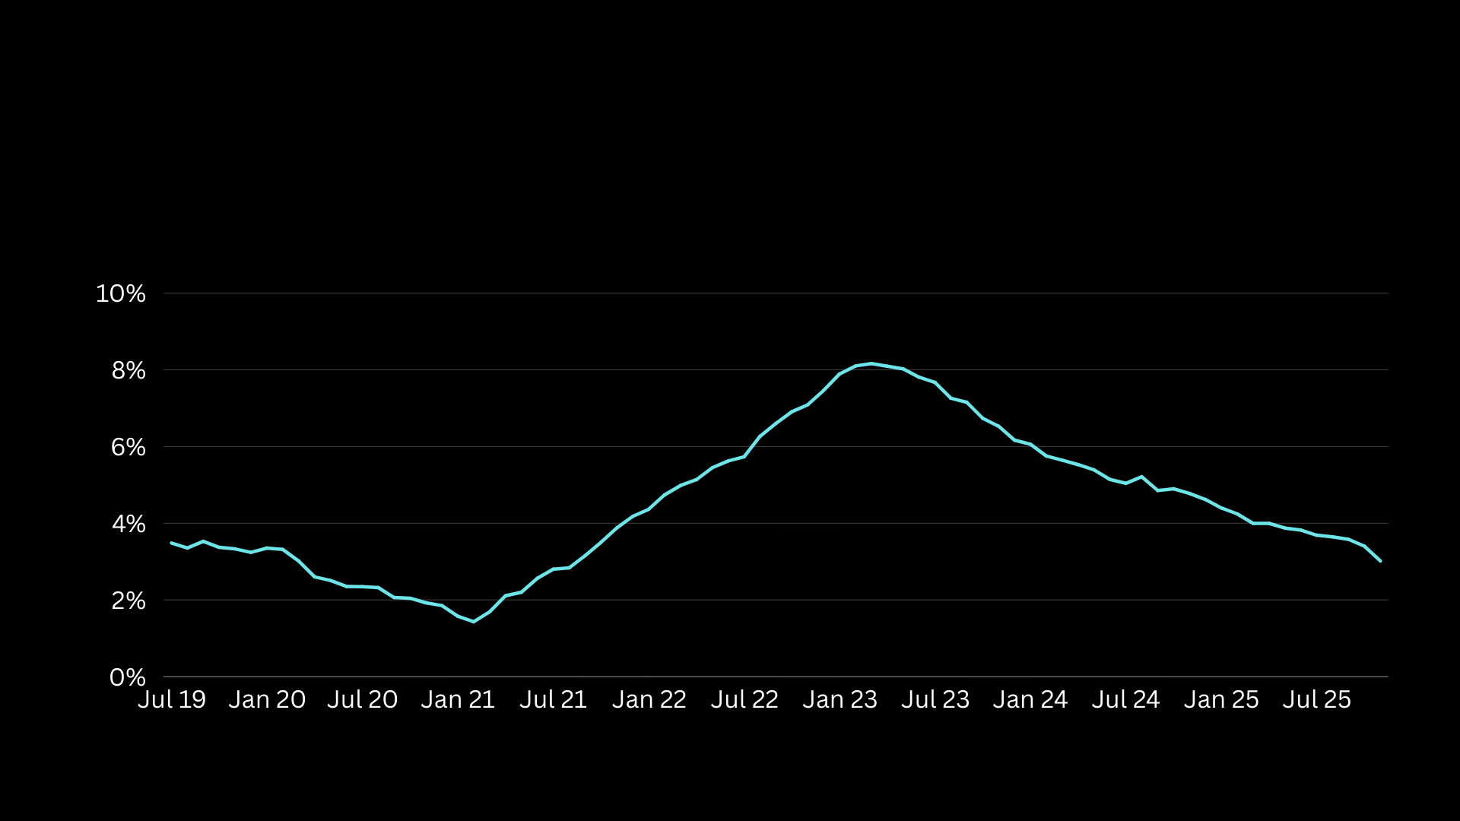
Rents
Actual New Rents -1.3%
Actual Renewals +3.0%
Average +1.9%
Shelter trending lower
3.7%

Slide 6
Inflation Forecast
Core PCE Inflation 2.8%
Overstatements:
Tariff 0.3%
Shelter Lag 0.3%
Portfolio Mgmt 0.3%
1.9%
12-mo Forecast 2.5%

Slide 7

2026 Forecast
Labor

Slide 8
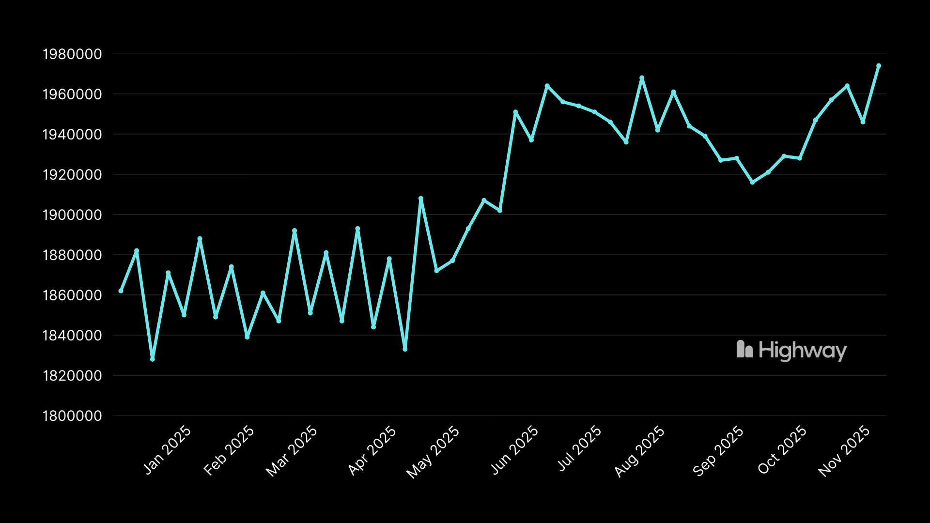
Harder to Find a Job After Being Let Go
Initial Claims do not reflect gig economy
Continuing Claims

Slide 9
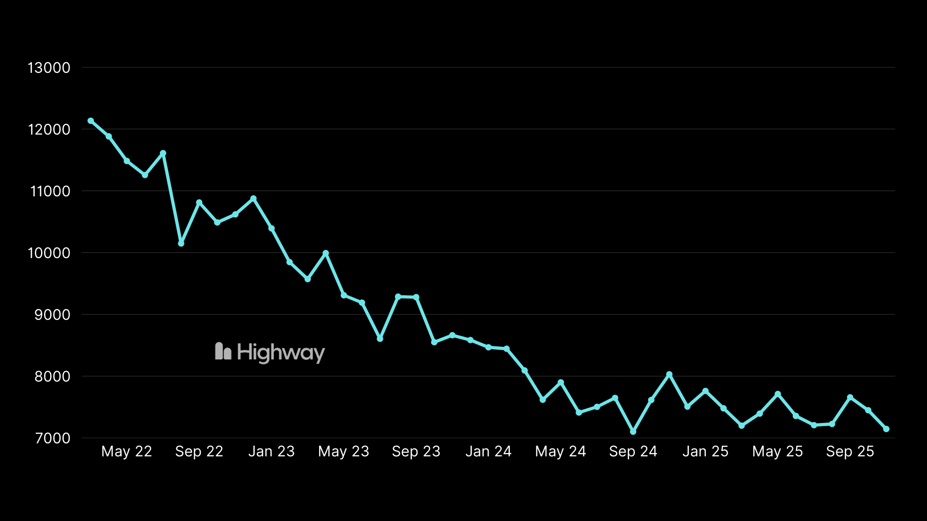
Job Openings Continuing to Slow
12M
Job Openings (JOLTS) clearly declining
7.1M

Slide 10
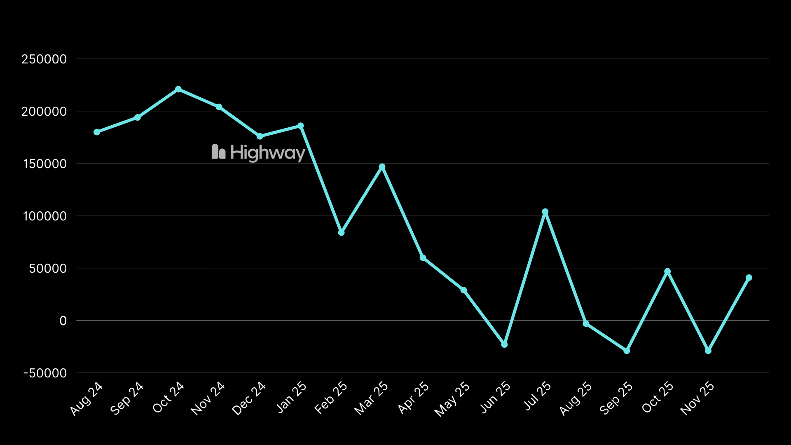
ADP Private Payrolls Very Weak
ADP job creations show significant declines
Source: ADP

Slide 11
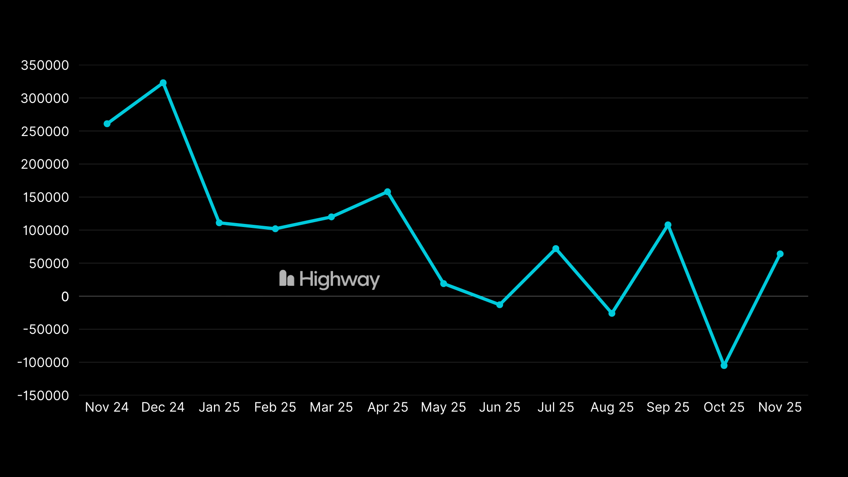
BLS Jobs Reports Weak but Still Overstated

Slide 12
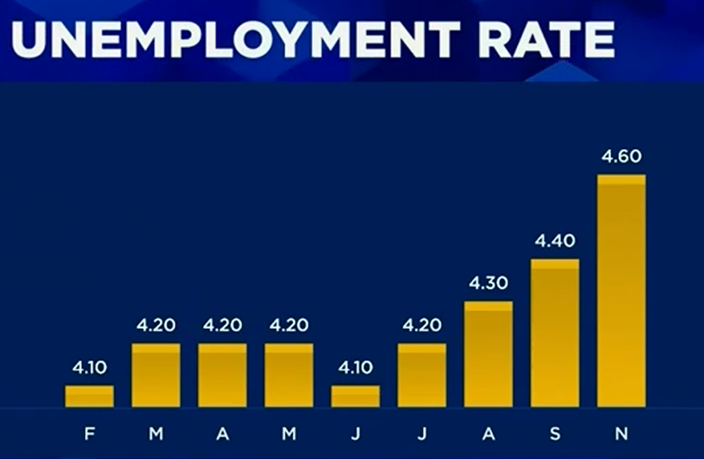
Job Revisions Q2 2024 – Q2 2025
Initial Final
BLS 1.923M 1.543M
QCEW 0.420M 0.420M
Overstatement 1.504M or 78% 1.114M or 73%
Birth/Death 1.119M (NSA)

Slide 13
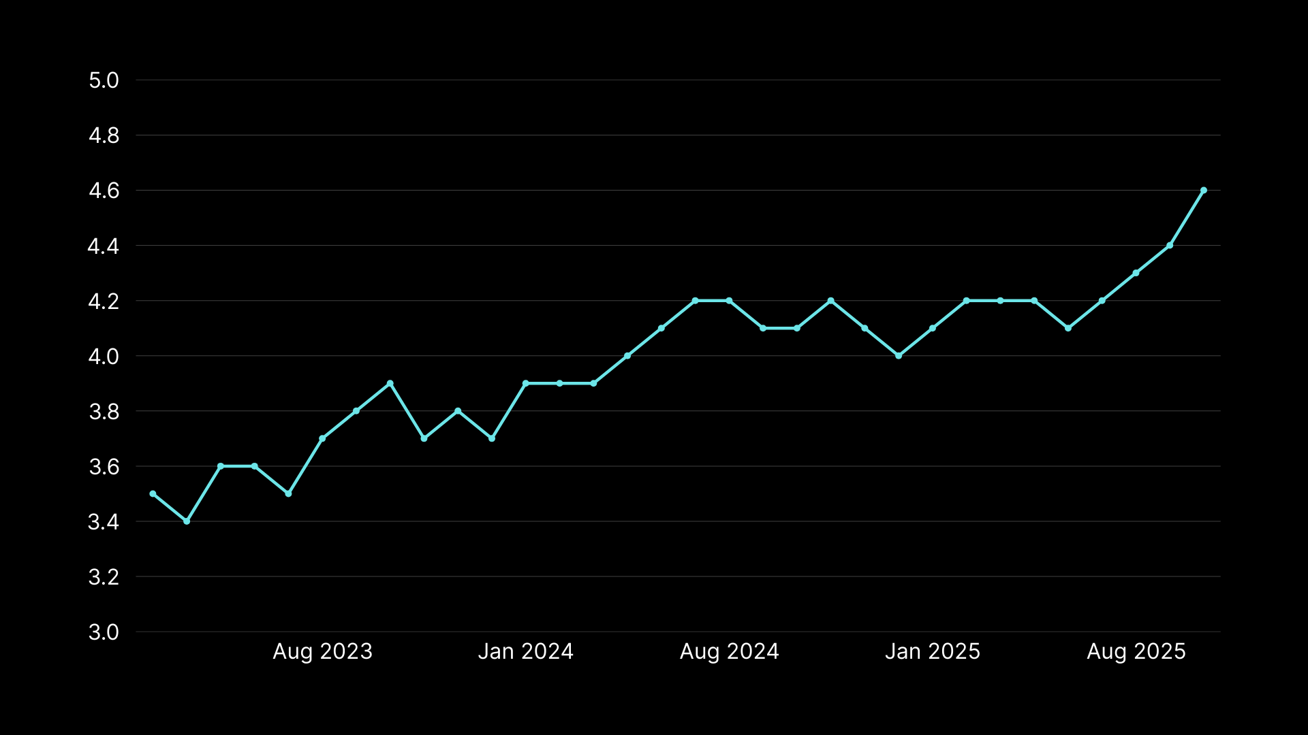
Unemployment Rate Rising
Forecast 4.8%

Slide 14
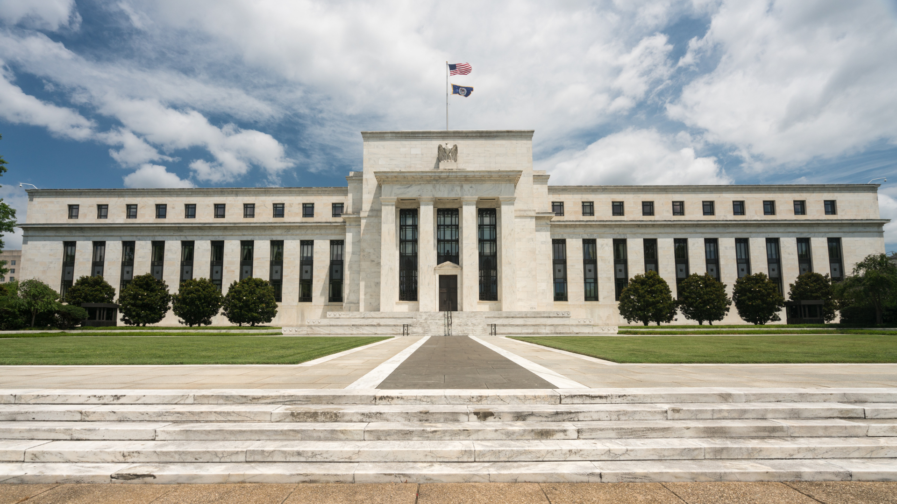
2026 Forecast
The Fed

Slide 15
2026 Fed Composition of Voting Members
Voting Member | Region/Governor | Dove/Hawk/Centrist
Fed Chair? |  | Dove
John Williams | New York | Dove
Michelle Bowman | Governor | Dove
Christopher Waller | Governor | Dove
Anna Paulson | Philadelphia | Dove
Michael Barr | Governor | Centrist
Philip Jefferson | Governor | Centrist
Neel Kashkari | Minneapolis | Centrist
Lisa Cook | Governor | Hawk
Beth Hammack | Cleveland | Hawk
Lorie Logan | Dallas | Hawk

Slide 16
Fed Funds Rate Forecast End of 2026
3.500% → 2.875%

Slide 17

2026 Forecast
Mortgage Rates

Slide 18
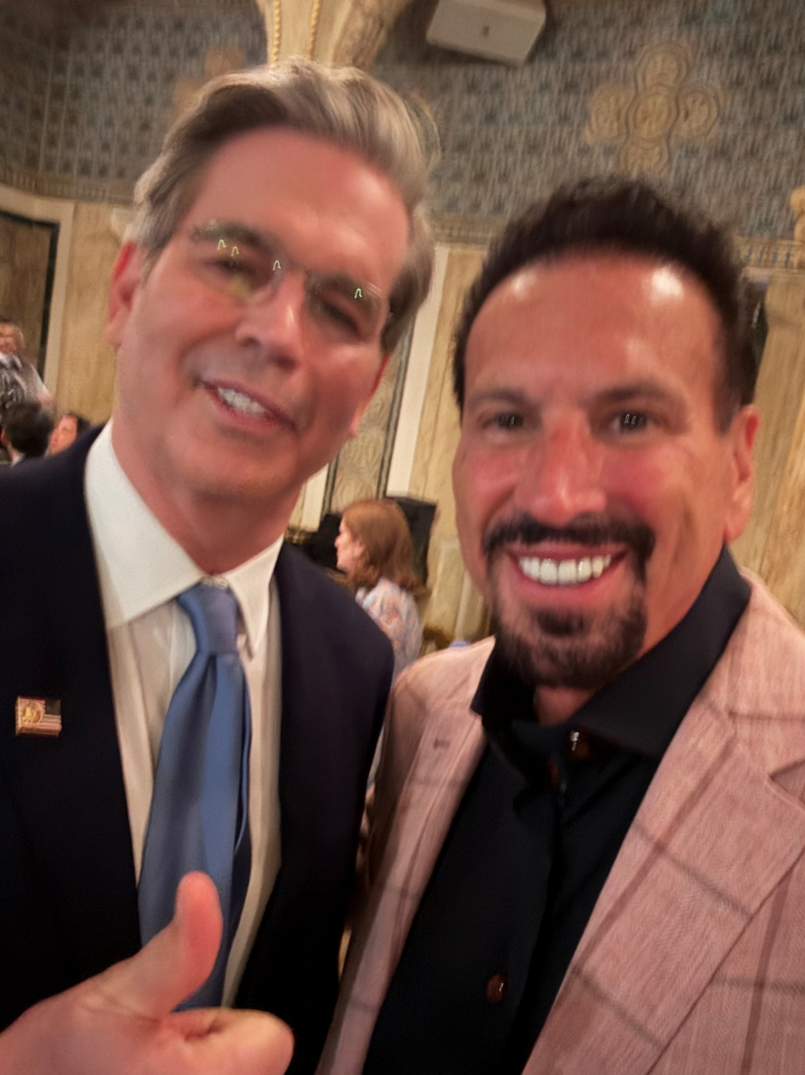
Scott Bessent Wants 10-Year Treasury Lower
And Wants Housing Market to “Un-freeze”
Bessent Target for 10-year Treasury is 3.9%
Factors That Will Influence Mortgage Rates
Additional debt
Terming debt shorter
GENIUS Act
Fed QE
Bank deregulation

Slide 19
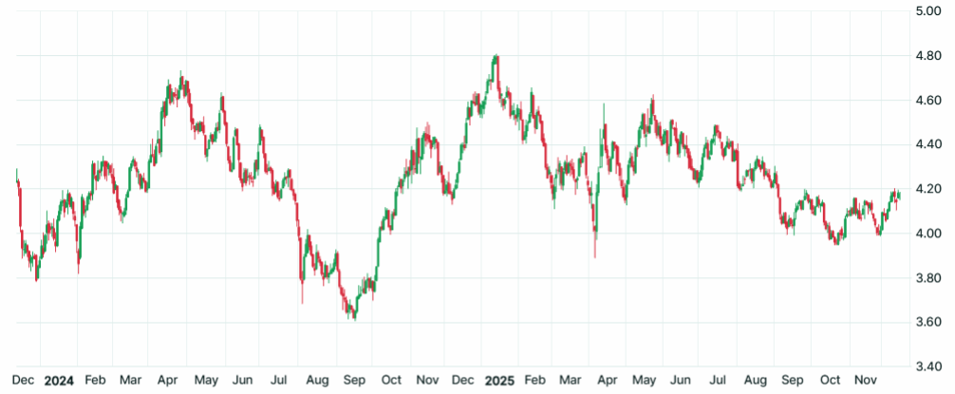
10-Year Treasury
3.8%
3.7%
3.6%

Slide 20
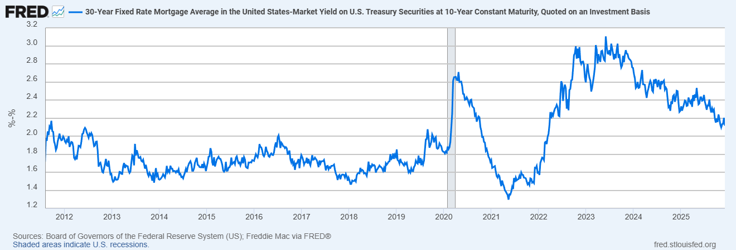
30-Year Fixed Mortgage Rate Spread
Above 10-Year Treasury
Jan 2025
2.6%
Current
2.12%

Slide 21
Mortgage Rate Forecast
10-year Treasury
Spread narrows
30-year FRM
3.80%
1.90%
5.70%

Slide 22
Market Mortgage Rate Forecast
Fannie Mae | 5.9%
NAR | 6.0%
Bright MLS | 6.13%
Zillow | 6.13%
Wells Fargo | 6.2%
NAHB | 6.2%
Realtor.com | 6.3%
Redfin | 6.3%
MBA | 6.4%
Average | 6.17%
MBS Highway | 5.70%

Slide 23

Loans Eligible to Refi
9.7
Millions
8.9
80% LTV
Rate savings 0.75%
720 FICO
7.9
6.8
5.8
4.9
3.5
3.0
2.4
Source: ICE McDash

Slide 24
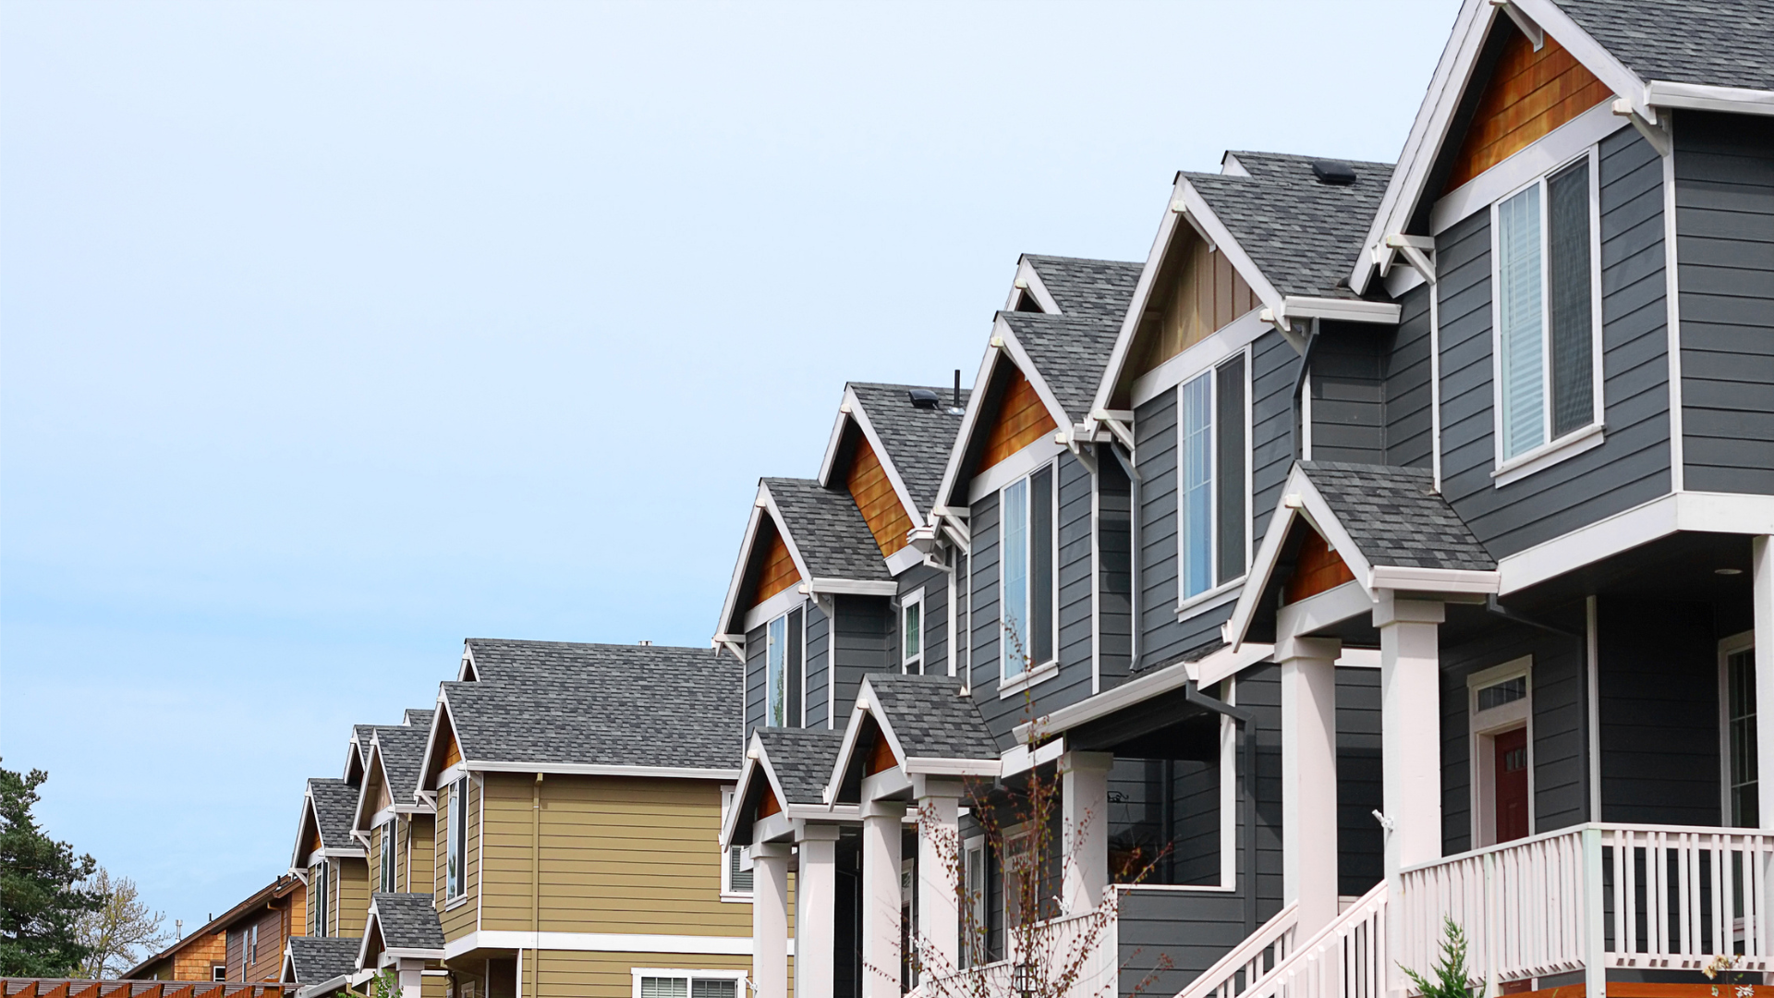
2026 Forecast
Real Estate

Slide 25
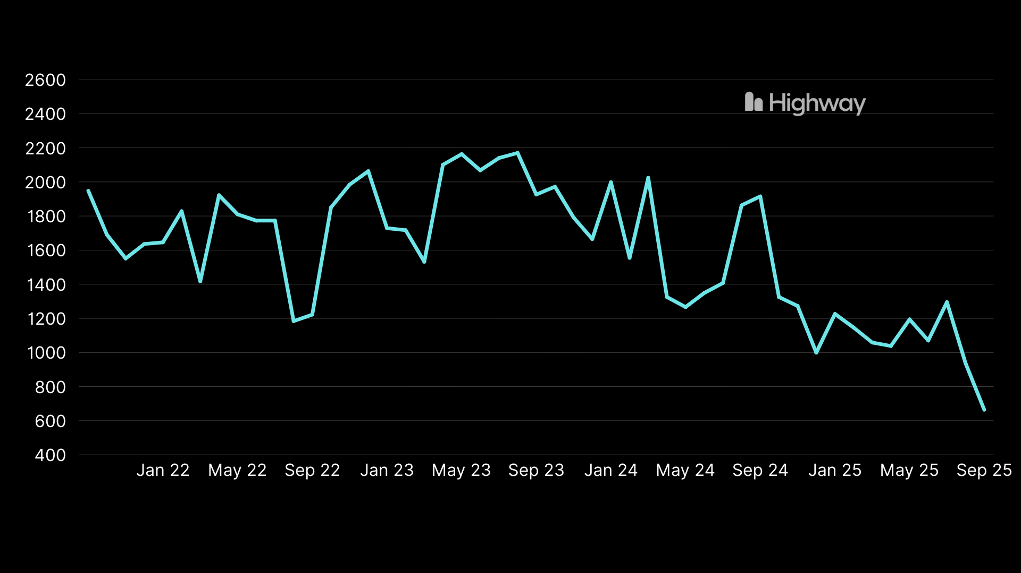
Household Formations
Demand
Average 1.8M
Pent-up Demand

Slide 26
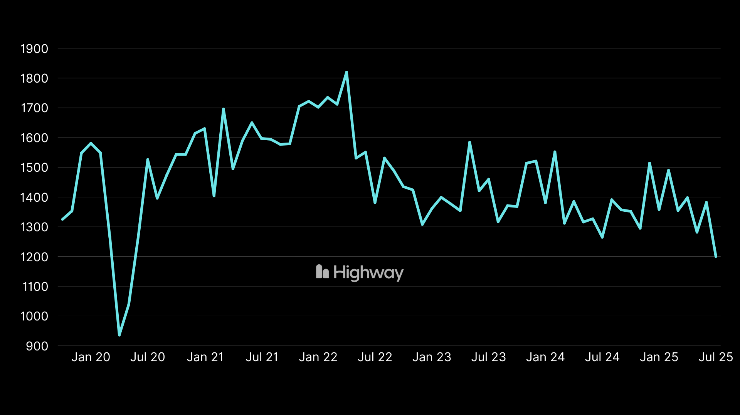
Housing Starts
Supply
1.2M

Slide 27
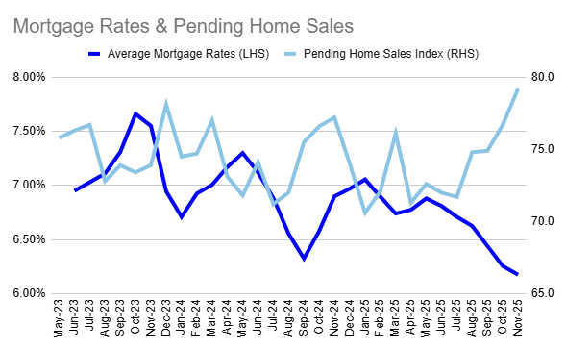

Slide 28
Market Real Estate Forecast
 | Home Prices YoY | Existing Home Sales
NAR | 4% | 14%
Fannie Mae | 1.3% | 7.8%
Zillow | 1.2% | 4.3%
Realtor.com | 2.2% | 1.7%
Redfin | 1% | 3%
Bright MLS | 0.9% | 9%
Cotality | 4.3%
Pulsenomics | 2.4%
Average | 2.16% | 6.63%
MBS Highway | 3.50%

Slide 29
2026 MBS Highway Forecasts
            Unemployment Rate 4.8%
            Core PCE Inflation 2.5%
            Fed Funds Rate 2.875%
            Mortgage rate low 5.25% - 5.70%
            Home price appreciation 3.5%

